Slide 1
Validation & Verification
1 V&V
2 Testing
3 CI & GitHub Actions
4 CI & Git Flow
Software Engineering Project
Validation & Verification
slide 1

Slide 2
Validation & Verification
1 V&V
2 Testing
3 CI & GitHub Actions
4 CI & Git Flow
Validation
Verification
“Are we building the right product?”
Does the system do what users really want?
Checked with: demos, user feedback, acceptance testing
“Are we building the product right?”
Does the system conform to its specification?
Checked with: tests, code review, continuous integration
Software Engineering Project
Validation & Verification
slide 2

Slide 3
Example: a hospital appointment app
1 V&V
2 Testing
3 CI & GitHub Actions
4 CI & Git Flow
Verification checks the system against the specification whereas validation checks it against the client’s needs.
Client needs
Requirements specification
System
Patients want to cancel a booking in one click
“Cancel via a form and confirm via email”
Cancelling requires text input and email confirmation
Verification: passes
Validation: fails
Wrong requirements are among the top cause of project failure
Software Engineering Project
Validation & Verification
slide 3

Slide 4
Testing as an Approach to V&V
1 V&V
2 Testing
3 CI & GitHub Actions
4 CI & Git Flow
Three kinds of testing you need to know about: development, release and acceptance testing
Development testing
Release testing
Acceptance testing
Who: the developers
When: while writing code, every sprint
Aim: find bugs and defects early
Who: a testing team
What: the complete system, as a whole
Before: it is released to users
Who: the client and users
Where: in their own environment
Aim: is this what we need?
Software Engineering Project
Validation & Verification
slide 4

Slide 5
Testing Phases
1 V&V
2 Testing
3 CI & GitHub Actions
4 CI & Git Flow
Development and release testing verify the system. Acceptance testing validates it.
Client needs
Requirements specification
System
Development and release testing
Acceptance testing
In an Agile sprint you will do all three: test as you build, test the whole system, then show the client
Software Engineering Project
Validation & Verification
slide 5

Slide 6
Multiple Levels of Testing
1 V&V
2 Testing
3 CI & GitHub Actions
4 CI & Git Flow
We do not need to test all components every time we make a change
Making a small backend change does not necessarily require all front-end and database components to be tested, for example
The more of the system we test, the slower the process becomes and the more computation it requires.
Most of your tests should be unit tests which are fast and cheap
System
Integration
Unit
Software Engineering Project
Validation & Verification
slide 6

Slide 7
Unit Tests
1 V&V
2 Testing
3 CI & GitHub Actions
4 CI & Git Flow
To test a program, you execute it with made-up (synthetic) inputs, and look for errors and anomalies in the outputs
The aim is to find defects: a successful test is one that finds a bug. However, absence of evidence is not evidence of absence!
Testing is how we give ourselves confidence that code is complete and correct.
day_of_week.py
test_day_of_week.py
from calendar import day_abbr
from datetime import date
def day_of_week(year, month, day):
d = date(year, month, day)
return day_abbr[d.weekday()]
from day_of_week import day_of_week
def test_day_of_week():
assert day_of_week(2026, 10, 23) == "Fri"
assert day_of_week(2026, 10, 24) == "Sat"
assert day_of_week(2024, 2, 29) == "Thu"
A unit test checks one small, isolated block of code, such as a function. It performs black box testing since it only asserts the output based on some input and ignores how the function really works.
Software Engineering Project
Validation & Verification
slide 7

Slide 8
Equivalence Partitioning
1 V&V
2 Testing
3 CI & GitHub Actions
4 CI & Git Flow
A partition is a group of inputs the code should treat the same way, so we test a few values from each, since we cannot test not every value
Here, each input has three partitions: too low (invalid), valid and too high (invalid)
Input | Invalid: too low | Valid | Invalid: too high
Day | below 1 -30, -1, 0 | 1–31 (28, 29, 30 or 31 by month) 1, 15, 27, 28, 29, 30, 31 | above 31 32, 40
Month | below 1 -12, -1, 0 | 1–12 1, 6, 12 | above 12 13, 30
Year | below 1 -2017, -1, 0 | 1–9999 00, 1, 69, 70, 1970, 2000, 9999 | above 9999 10000
We should test just inside and just outside each partition boundary (in blue above)
We should think of edge cases e.g., 29 Feb 2024 is valid, 29 Feb 2026 is not because of leap years
There are also design choices to make - someone must decide, e.g. a year limit, or whether 00 means 1900 or 2000
Software Engineering Project
Validation & Verification
slide 8
Notes:
What are the inputs? Write down every one
Which values are valid, and which are not? Think in partitions
Where are the boundaries? Test just inside and just outside them
Which test would you write first? Start with the simplest case

Slide 9
Test-Driven Development (TDD)
1 V&V
2 Testing
3 CI & GitHub Actions
4 CI & Git Flow
Test-driven development (TDD) is a software development process which is very common in Agile where you write an automated unit test before you write the production code
You do not write all the tests, then all the code. TDD relies strictly on a three step (red, green, refactor) cycle (we will go through an example)
Red: write a test for one requirement which must initially fail
Green: write the smallest code that passes without optimising
Refactor: only once all tests are green should you refactor and re-run tests after every change
Software Engineering Project
Validation & Verification
slide 9

Slide 10
TDD in Code
1 V&V
2 Testing
3 CI & GitHub Actions
4 CI & Git Flow
Cycle 1
Cycle 2
Cycle 3
Write one test case for one date, then run it: it must fail.
Make it pass with the smallest possible code.
Add a second case: the hard-coded value now fails.
Import the date library: the function now works.
Tidy up with the test green: same behaviour, less code.
A new requirement arrives: invalid dates return None.
Handle the error: all three cases pass.
Red
Red
Green
Green
Refactor
Refactor
day_of_week.py
test_day_of_week.py
def day_of_week(year, month, day):
from datetime import date
def day_of_week(year, month, day):
d = date(year, month, day)
names = ["Mon", "Tue", "Wed", "Thu",
"Fri", "Sat", "Sun"]
return names[d.weekday()]
from calendar import day_abbr
from datetime import date
def day_of_week(year, month, day):
d = date(year, month, day)
return day_abbr[d.weekday()]
from calendar import day_abbr
from datetime import date
def day_of_week(year, month, day):
d = date(year, month, day)
return day_abbr[d.weekday()]
# imports unchanged
def day_of_week(year, month, day):
try:
d = date(year, month, day)
except ValueError:
return None
return day_abbr[d.weekday()]
from day_of_week import day_of_week
def test_day_of_week():
assert day_of_week(2026, 10, 23) == "Fri"
return None
return "Fri" # was None
return "Fri"
assert day_of_week(2026, 10, 24) == "Sat"
assert day_of_week(2026, 10, 24) == "Sat"
assert day_of_week(2026, 13, 45) is None
assert day_of_week(2026, 13, 45) is None
pytest
pytest
pytest
FAILED test_day_of_week
assert None == 'Fri'
1 failed
PASSED test_day_of_week
1 passed
FAILED test_day_of_week
assert 'Fri' == 'Sat'
1 failed
PASSED test_day_of_week
1 passed
FAILED test_day_of_week
ValueError: month must be in 1..12
1 failed
PASSED test_day_of_week
1 passed
Run it before writing logic: the failure proves the test can fail
The Friday case still passes: only the new case fails
Now that our tests have gone green we can think about refactoring
Refactor only on green: the same test re-runs and must still pass
The case list keeps growing: each new requirement starts as a failing case
All three cases run every time: a new case cannot silently break an old one
Software Engineering Project
Validation & Verification
slide 10

Slide 11
TDD and Git
1 V&V
2 Testing
3 CI & GitHub Actions
4 CI & Git Flow
Commit at each step of the cycle: red, green, refactor.
git log --oneline
pytest after each commit
7c1e9a4 refactor: use calendar.day_abbr (#12)
a3d5f02 feat: return None for invalid dates (#12)
9be0c71 test: add invalid date case (#12)
5be8c31 feat: support any date (#12)
2d4a8e6 test: add Saturday case (#12)
1f0d9e7 feat: day_of_week for one date (#12)
0c7b3a5 test: add Friday case (#12)
PASSED 3 passed
PASSED 3 passed
FAILED 1 failed
PASSED 2 passed
FAILED 1 failed
PASSED 1 passed
FAILED 1 failed
As we saw last week, the commit history tells a story: each test says what we wanted, the next commit how we did it
Software Engineering Project
Validation & Verification
slide 11

Slide 12
Benefits and Limitations of TDD
1 V&V
2 Testing
3 CI & GitHub Actions
4 CI & Git Flow
Benefits
Limitations
It forces you to think about the design of the code first: tests written afterwards tend to repeat the code’s mistakes
It catches bugs early: when a test fails, it is generally the last change that caused it
It gives you confidence to make changes, because existing tests warn you if something breaks
Since every line of code has at least one test your code will have good coverage
Tests are good system documentation - test names and asserts describe what the code should do
Passing tests show the code works for the cases you thought of, and nothing more
Tests can be wrong or thin – the previous example returned “Fri” for every date and still passes our one test
Failing tests must be fixed and therefore require maintenance - each requirement change can mean test changes
Software Engineering Project
Validation & Verification
slide 12

Slide 13
Continuous Integration
1 V&V
2 Testing
3 CI & GitHub Actions
4 CI & Git Flow
Even with good tests, many things can break when integrating code
  Software needs to run on different operating systems, library versions and hardware, so tests that pass on your laptop may fail on a teammate’s (“it works on my machine”)
  Tests alone are not enough: developers may forget to run the tests before merging, or several branches that each pass their own tests may break in combination
Continuous integration (CI) is a practice that helps with this: developers integrate their code into a shared repository frequently, and each integration is verified by an automated build and tests
  The aim is to detect integration errors as early as possible, when they are easier to fix
How does this work? At a high level, events (pushes, PRs, merges) trigger automatic builds and tests on a dedicated CI server
Software Engineering Project
Validation & Verification
slide 13

Slide 14
CI Workflows & GitHub Actions
1 V&V
2 Testing
3 CI & GitHub Actions
4 CI & Git Flow
There are many popular CI/CD providers (GitLab, Jenkins, TravisCI), but we will be using GitHub’s built-in automation platform for CI and CD, GitHub Actions.
Let’s say you push a feature branch. This will start an automatic build and test on a clean machine.
Push
to feat/12/
day-of-week
Fresh runner
a clean virtual machine
Checkout
copy your code onto it
Install
the dependencies
Run fast tests
lint + unit tests
GitHub Actions does all of this for you
The push in this example is an event. There are many other events including PRs. The event triggers a runner, which is a GitHub-hosted machine (Linux, Windows, macOS), for our tests to run on.
The workflows are highly configurable, and work with GitHub Packages, Docker and cloud services, such as AWS. A workflow is just a YAML file in your repo (.github/workflows/ci.yml)
Software Engineering Project
Validation & Verification
slide 14

Slide 15
Workflow Files
1 V&V
2 Testing
3 CI & GitHub Actions
4 CI & Git Flow
A workflow lives in .github/workflows/ and is read top to bottom.
.github/workflows/ci.yml
The label shown in the Actions tab
name
name: Python Tests
on:
push:
jobs:
test:
runs-on: ubuntu-latest
steps:
- uses: actions/checkout@v7
- uses: actions/setup-python@v7
with:
python-version: "3.12"
- run: pip install pytest
- run: python -m pytest test.py
Events that trigger the workflow
on
Each job gets its own runner. Test is the job ID
jobs
Which machine runs the job
runs-on
Run in order: uses = an action, run = a command
steps
Software Engineering Project
Validation & Verification
slide 15

Slide 16
Multiple Jobs in One Workflow
1 V&V
2 Testing
3 CI & GitHub Actions
4 CI & Git Flow
A workflow can hold several jobs, each with a name you choose.
.github/workflows/ci.yml
jobs:
lint:
runs-on: ubuntu-latest
steps:
- run: flake8 .
build:
runs-on: ubuntu-latest
steps:
- run: python -m build
test:
needs: [lint, build]
runs-on: ubuntu-latest
steps:
- run: pytest
Runs at once, in parallel
lint
Runs at once, in parallel
build
Waits for lint and build to pass
test
This is parallel by default. We can use needs to make a job wait for another
Software Engineering Project
Validation & Verification
slide 16

Slide 17
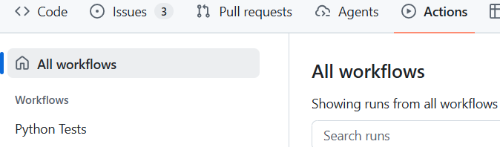
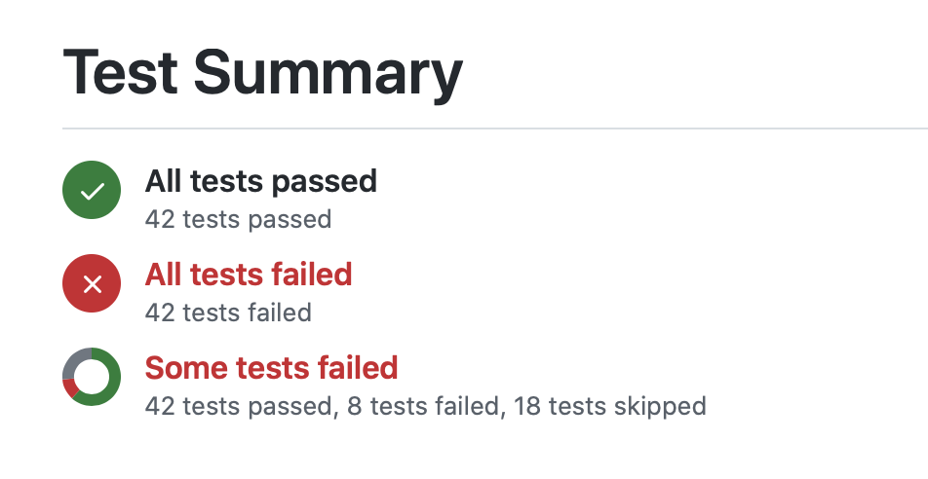
Accessing Workflows in GitHub
1 V&V
2 Testing
3 CI & GitHub Actions
4 CI & Git Flow
terminal
git add .github/workflows/ci.yml
git commit -m "ci: run pytest on every push (#14)"
git push -u origin feat/14/add-ci
1 Push starts the workflow
2 Open the Actions tab
3 Select your workflow by name
4 Check the result of the run
Each run reports pass or fail, with a summary of the tests that ran
Software Engineering Project
Validation & Verification
slide 17

Slide 18
Configuring CI
1 V&V
2 Testing
3 CI & GitHub Actions
4 CI & Git Flow
In our simple example, tests would run whenever we pushed changes to the repository. We can configure which events and branches we want to automate building and testing for
Use push or pull_request as trigger events and branches to target specific branches. Note that branches is the branch the PR targets. Use patterns to match several branches, e.g. feat/**
For example, we may only want unit tests and linting to run when pushing to a feature branch, so we create a fast.yml for this
fast.yml: pushes to feature branches
push:
branches: ['feat/**', bug/**']
We may well want more extensive testing to run for PRs relating to dev and main.
pr.yml: pull requests into dev or main
pull_request:
branches: [dev, main]
All tests passing in the CI should be a checkbox in your PR template!
Software Engineering Project
Validation & Verification
slide 18

Slide 19
OS & Versions
1 V&V
2 Testing
3 CI & GitHub Actions
4 CI & Git Flow
We can also run extensive testing across different operating systems and versions.
.github/workflows/pr.yml
This matrix runs every combination of the 2 operating systems and Python versions. This means 4 build and test jobs from a single definition
This gives us assurance that our code works across the environments it will be deployed to
However, we do not always want such heavy automation: more combinations cost more runner minutes!
jobs:
test:
strategy:
matrix:
os: [ubuntu-latest, windows-latest]
python-version: ["3.11", "3.12"]
runs-on: ${{ matrix.os }}
steps:
- uses: actions/setup-python@v7
with:
python-version: ${{ matrix.python-version }}
Software Engineering Project
Validation & Verification
slide 19

Slide 20
Hooking Up Releases
1 V&V
2 Testing
3 CI & GitHub Actions
4 CI & Git Flow
Merging to main or pushing a tag is the hook that starts a release.
release.yml
A push to main or a tag matching v* (such as v1.1) starts the workflow
needs: test makes deploy wait for the tests, and skips it if they fail
env sets variables for a job; secrets keep deploy credentials out of the file
Never commit an API key: add it under Settings > Secrets and variables > Actions
Secrets are encrypted and masked in logs
on:
push:
branches: [main]
tags: ["v*"]
jobs:
test:
runs-on: ubuntu-latest
steps:
- run: pytest
deploy:
needs: test
runs-on: ubuntu-latest
env:
DEPLOY_TOKEN: ${{ secrets.DEPLOY_TOKEN }}
API_KEY: ${{ secrets.API_KEY }}
Software Engineering Project
Validation & Verification
slide 20

Slide 21
Task-specific Workflow Files
1 V&V
2 Testing
3 CI & GitHub Actions
4 CI & Git Flow
In fact, it is a good idea to have a setup which looks something like this:
repository
.github/workflows/
fast.yml # push to feature branches: lint, unit tests
pr.yml # pull request into dev: full unit suite, integration tests, OS matrix
release.yml # push to main or tag v*: build and deploy
A handful of smaller files are easier to read since each one does a single job.
Within the Actions tab on GitHub, each shows up as its own workflow so you can see which one failed.
The slowest checks, such as end-to-end and performance tests, run only at release time, not on every push.
Software Engineering Project
Validation & Verification
slide 21

Slide 22
CI in Git Flow
1 V&V
2 Testing
3 CI & GitHub Actions
4 CI & Git Flow
CI runs at every point where code is integrated, but different branches run different checks.
v1.0
v1.1
main
release
3
dev
2
feature
2
1
1
Feature branch: unit tests and linting (fast.yml)
2
PR into dev: full unit suite, integration and API tests, OS version matrix (pr.yml)
3
Release: end-to-end and UI tests, performance and load tests (release.yml)
Software Engineering Project
Validation & Verification
slide 22

Slide 23
Making CI Efficient
1 V&V
2 Testing
3 CI & GitHub Actions
4 CI & Git Flow
The further code travels towards main, the more we check.
fast, cheap, frequent
slow, thorough, rare
feature
PR / merge
dev
branch off
release
PR / merge
main
unit tests + linting
+ integration and API tests, OS version matrix
+ end-to-end and UI tests, performance and load tests
+ deploy
Runner minutes are limited! GitHub gives the whole organisation a fixed number each month, and every run spends from the same pool. Try not to shut down the whole org!
The heaviest tests should run only a handful of times over the whole unit, not on every push
Skip runs you do not need
Use Linux by default
Cache dependencies
on:
push:
paths-ignore:
- "docs/**"
Billed minutes per minute used
- uses: actions/setup-python@v7
with:
python-version: "3.12"
cache: pip
Linux
1×
Windows
2×
Docs-only pushes start no run
macOS
10×
Reuses downloaded packages, so runs are faster and cheaper
Software Engineering Project
Validation & Verification
slide 23

Slide 24
Questions?
1 V&V
2 Testing
3 CI & GitHub Actions
4 CI & Git Flow
Software Engineering Project
Validation & Verification
slide 24

